Slide 1
Hash functions

Slide 2
MD 5 ( Message Digest 5)
A cryptographic hash algorithm that can be used to create a 128-bit string value from an arbitrary length string
Most commonly used to verify the integrity of files
Designed by R. Rivest based on Markel-Damgard construction for building collision resistance cryptographic hash function.

Slide 3
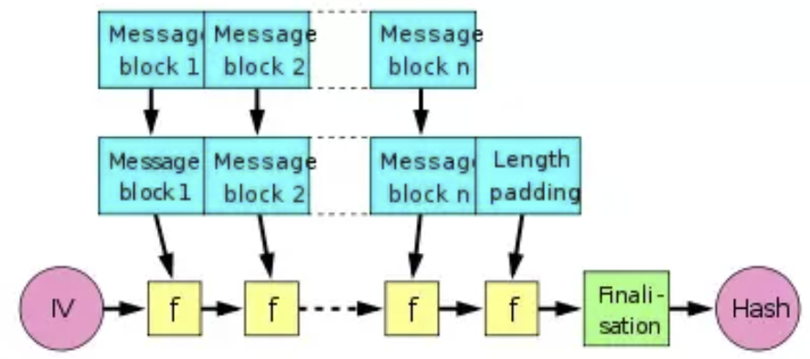
MD5 ALGORITHM
In this method, original file is padded and split into N equal sized block and compute a 128 bit hash value of the entire message through chaining.
For better readability, it is often represented in hexadecimal notations.

Slide 4
In the diagram, the one-way compression function is denoted by f and transforms two fixed length inputs to an output of the same size as one of the inputs.
The algorithm starts with an initial value, the initialization vector(IV). The IV is a fixed value.
For each message block, the compression function f takes the result so far, combines it with the message block and produces an intermediate result.
The last block is padded with zeros as needed and bits representing the length of the entire message are appended

Slide 5
SHA (Secure Hash Algorithms)
An algorithm that consists of bitwise operations, modular additions and compression functions.
The has function produces a fixed-size string that looks nothing like the original.
SHA-0: The original version of the 160-bit hash function published in 1993.
SHA-1: A 160 bit hash function which resembles the earlier MD5 algorithm.
SHA-2: A family of two similar hash function with different block sizes, known as SHA-256 and SHA-512.
SHA-256 uses 32-byte words whereas SHA-512 uses 64-byte words.

